Slide 2
Chapter 4
Building an E-commerce Presence: Web Sites, Mobile Sites, and Apps
Copyright © 2014 Pearson Education, Inc.

Slide 3
Tommy Hilfiger Replatforms
What reasons were behind Hilfiger’s choice of ATG for its Web site solution?
Why did Hilfiger decide it needed to replatform in 2011?
What are some of the site-building options for operators of smaller Web sites?
Copyright © 2014 Pearson Education, Inc.
Slide 4-<number>

Slide 4
Imagine Your E-commerce Presence
What’s the idea?
  Vision
  Mission statement
  Target audience
  Intended market space
  Strategic analysis
  Internet marketing matrix
  Development timeline and preliminary budget
Copyright © 2014 Pearson Education, Inc.
Slide 4-<number>

Slide 5
Imagine Your E-commerce Presence (cont.)
Where’s the money?
  Business model(s):
    Portal, e-tailer, content provider, transaction broker, market creator, service provider, community provider
  Revenue model(s):
    Advertising, subscriptions, transaction fees, sales, and affiliate revenue.
Copyright © 2014 Pearson Education, Inc.
Slide 4-<number>

Slide 6
Imagine Your E-commerce Presence (cont.)
Who and where is the target audience?
  Describing your audience
    Demographics
      Age, gender, income, location
    Behavior patterns (lifestyle)
    Consumption patterns (purchasing habits)
    Digital usage patterns
    Content creation patterns (blogs, Facebook)
    Buyer personas
Copyright © 2014 Pearson Education, Inc.
Slide 4-<number>

Slide 7
Imagine Your E-commerce Presence (cont.)
Characterize the marketplace
  Demographics
  Size, growth, changes
  Structure
    Competitors
    Suppliers
    Substitute products
Where is the content coming from?
  Static or dynamic?
Copyright © 2014 Pearson Education, Inc.
Slide 4-<number>

Slide 8
Imagine Your E-commerce Presence (cont.)
Know yourself—SWOT analysis
Develop an e-commerce presence map
Develop a timeline: Milestones
How much will this cost?
  Simple Web sites: up to $5000
  Small Web start-up: $25,000 to $50,000
  Large corporate site: $100,000+ to millions
Copyright © 2014 Pearson Education, Inc.
Slide 4-<number>

Slide 9
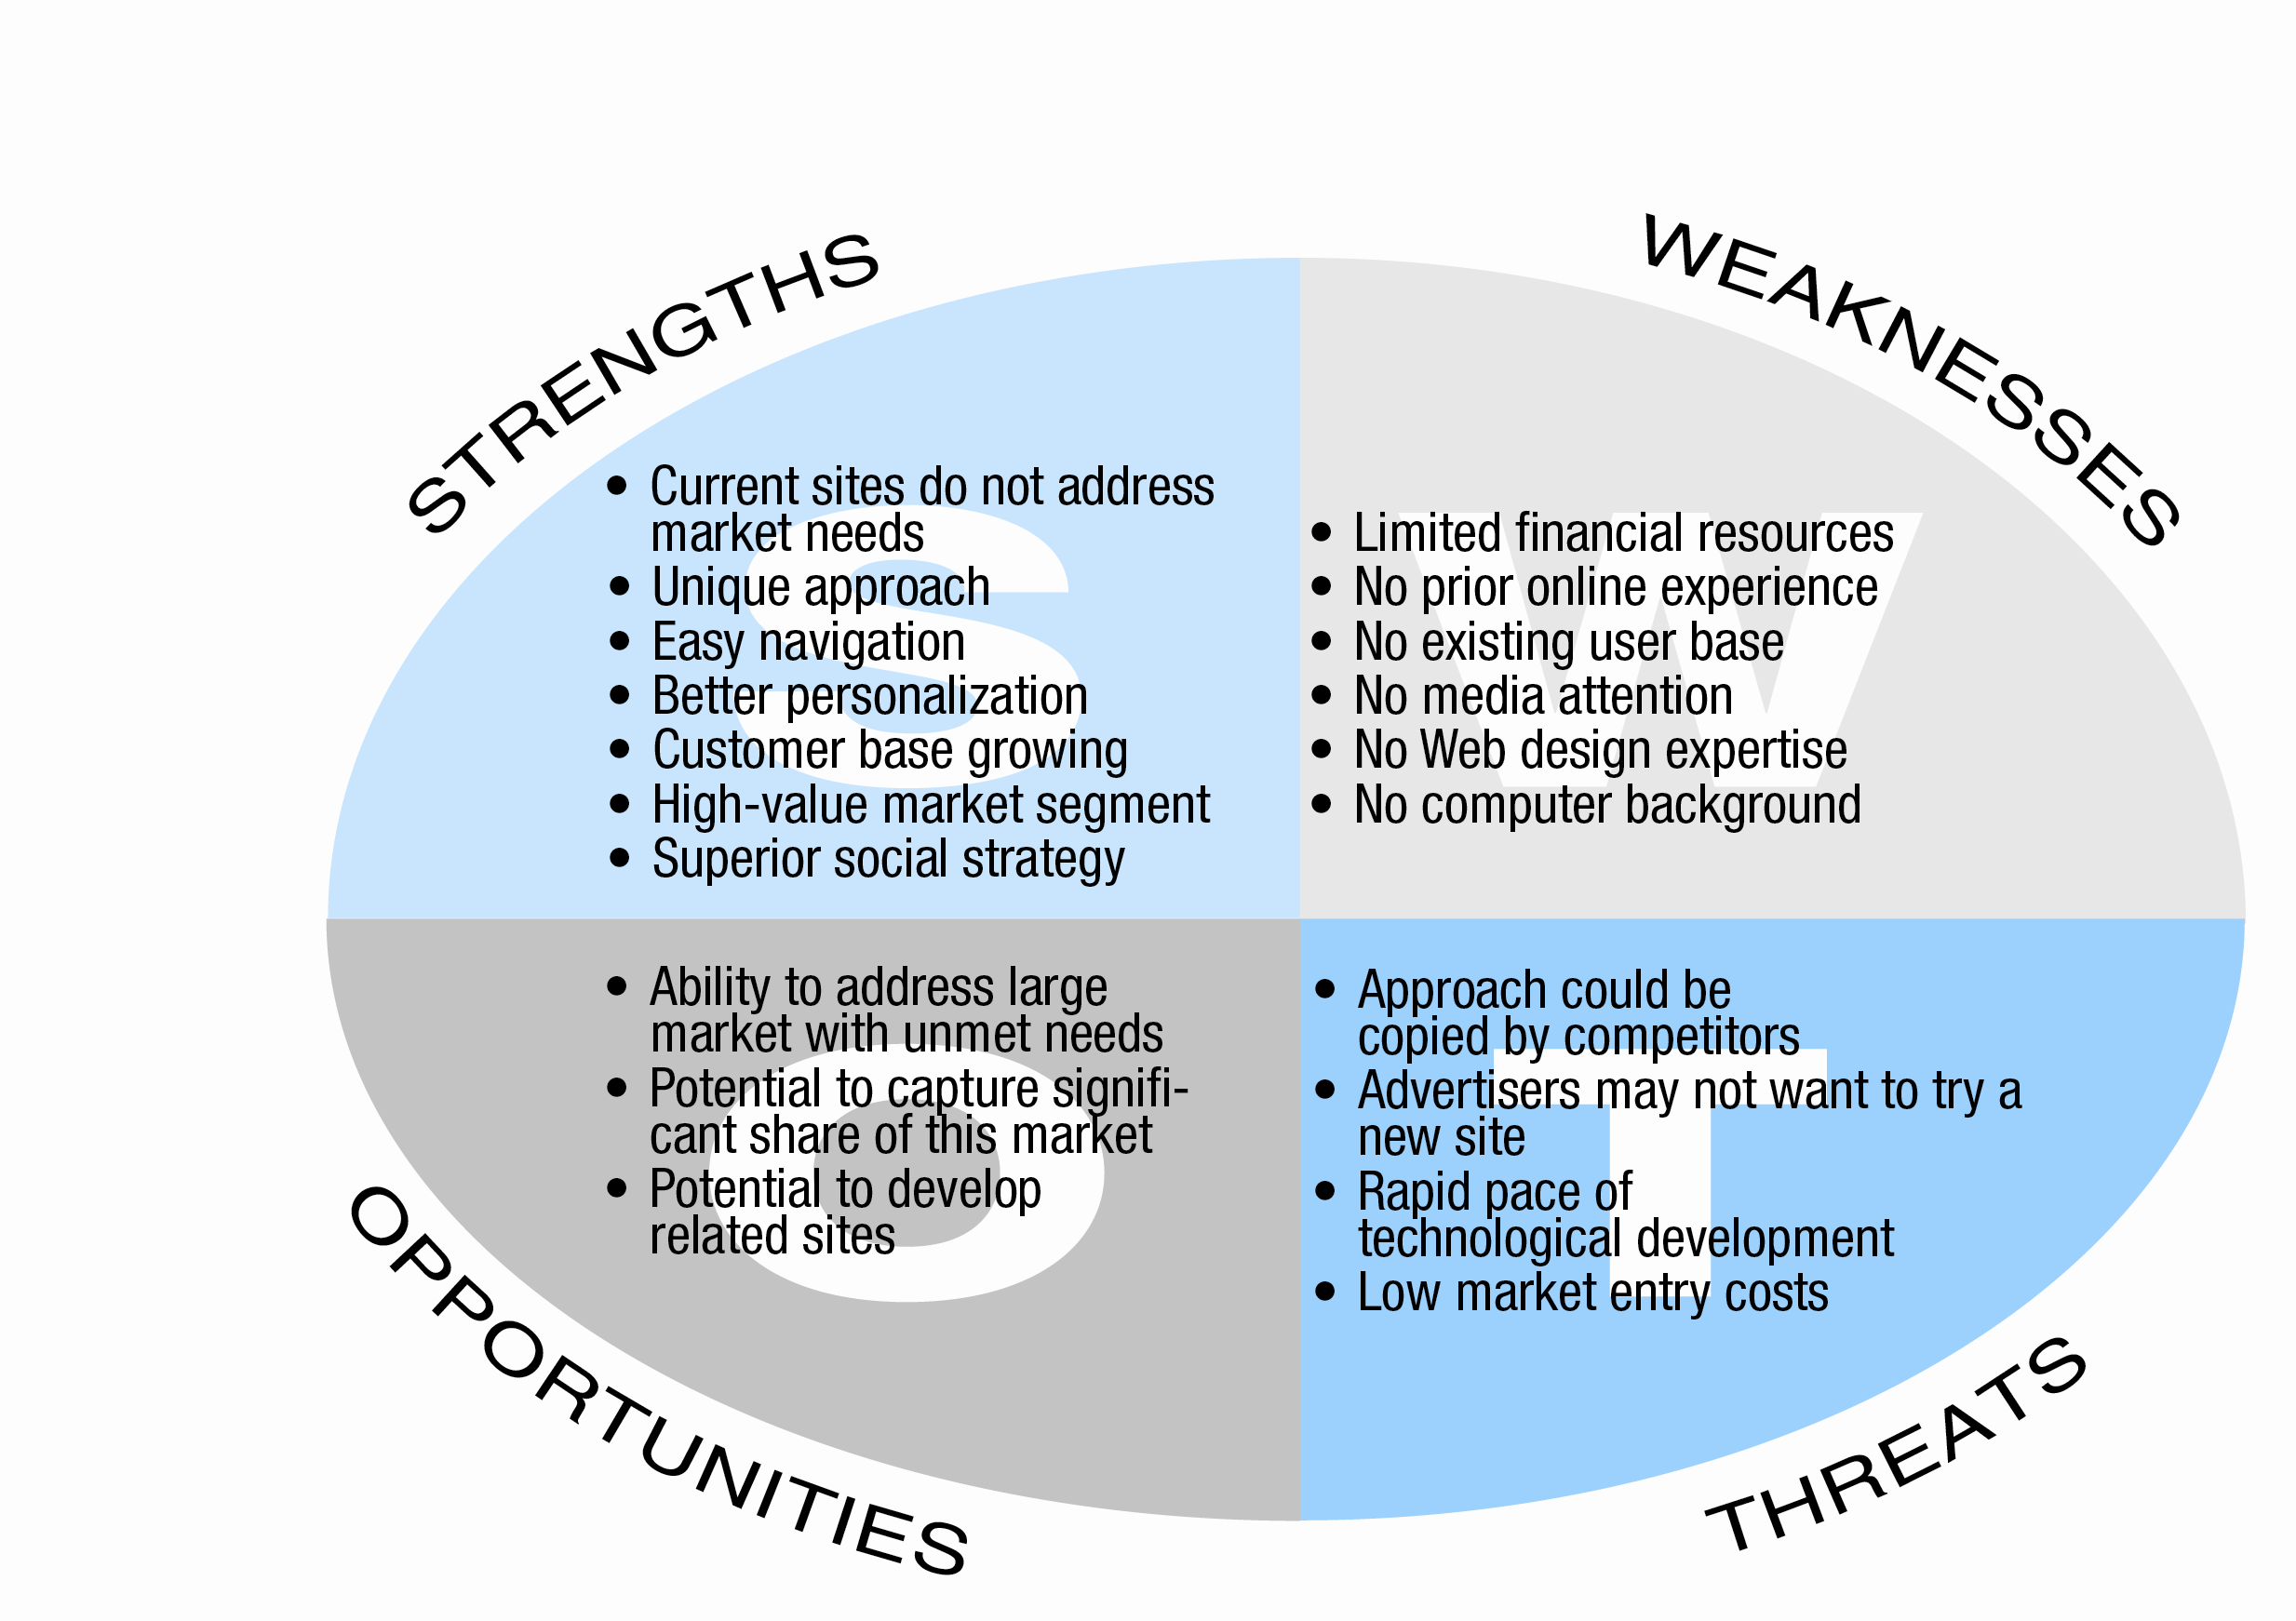
SWOT Analysis
Figure 4.1, page 126
Copyright © 2014 Pearson Education, Inc.
Slide 4-<number>

Slide 10
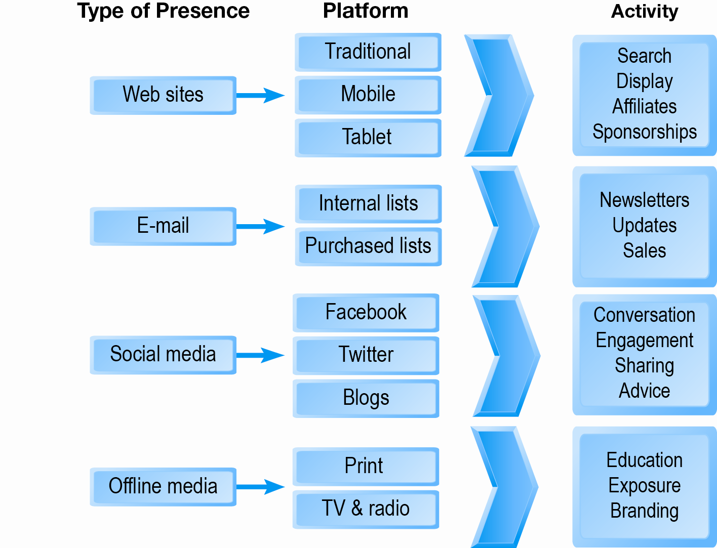
E-commerce Presence Map
Figure 4.2, page 127
Copyright © 2014 Pearson Education, Inc.
Slide 4-<number>

Slide 11
Building an E-commerce Presence:
A Systematic Approach
Most important management challenges:
  Developing a clear understanding of business objectives
  Knowing how to choose the right technology to achieve those objectives
Copyright © 2014 Pearson Education, Inc.
Slide 4-<number>

Slide 12
Pieces of the Site-Building Puzzle
Main areas where you will need to make decisions:
  Human resources and organizational capabilities
    Creating a team with the skill set needed to build and manage a successful site
  Hardware/software
  Telecommunications
  Site design
Copyright © 2014 Pearson Education, Inc.
Slide 4-<number>

Slide 13
The Systems Development Life Cycle
Methodology for understanding business objectives of a system and designing an appropriate solution
Five major steps:
  Systems analysis/planning
  Systems design
  Building the system
  Testing
  Implementation
Copyright © 2014 Pearson Education, Inc.
Slide 4-<number>

Slide 14
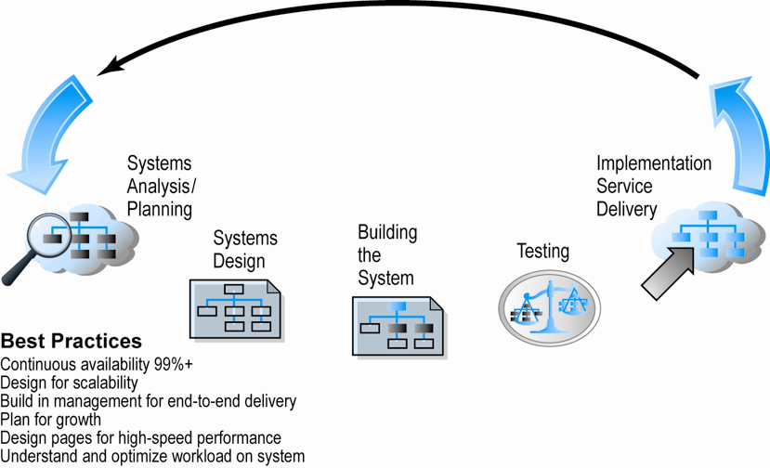
Web Site Systems Development Life Cycle
Figure 4.5, Page 131
Copyright © 2014 Pearson Education, Inc.
Slide 4-<number>

Slide 15
System Analysis/Planning
Business objectives
  List of capabilities you want your site to have
System functionalities
  List of information system capabilities needed to achieve business objectives
Information requirements
  Information elements that system must produce in order to achieve business objectives
Copyright © 2014 Pearson Education, Inc.
Slide 4-<number>

Slide 16
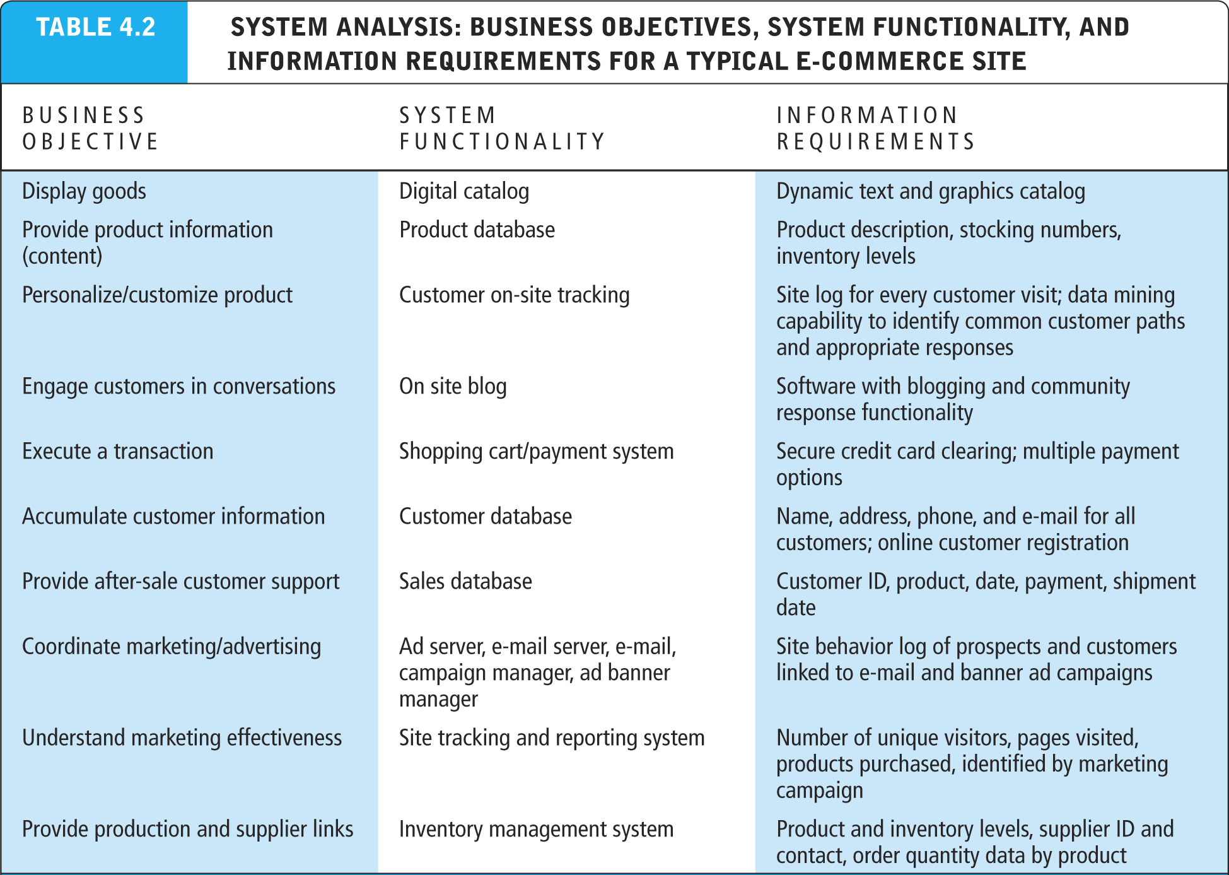
Table 4.2, page 132
Copyright © 2014 Pearson Education, Inc.
Slide 4-<number>

Slide 17
Systems Design:
Hardware and Software Platforms
System design specification
  Description of main components of a system and their relationship to one another
Two components of system design:
  Logical design
    Data flow diagrams, processing functions, databases
  Physical design
    Specifies actual physical, software components, models, etc.
Copyright © 2014 Pearson Education, Inc.
Slide 4-<number>

Slide 18
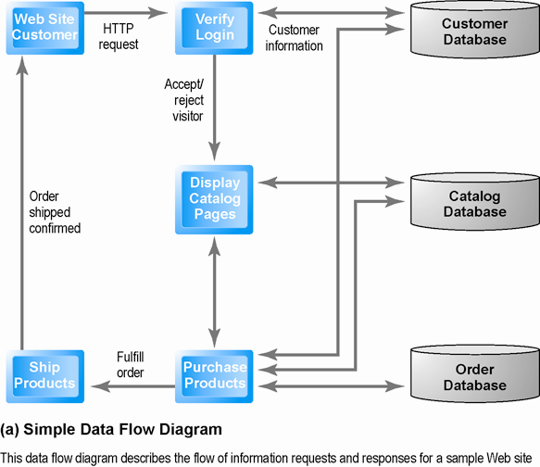
Logical Design for a Simple Web Site
Figure 4.6 (a), Page 134
Copyright © 2014 Pearson Education, Inc.
Slide 4-<number>

Slide 19
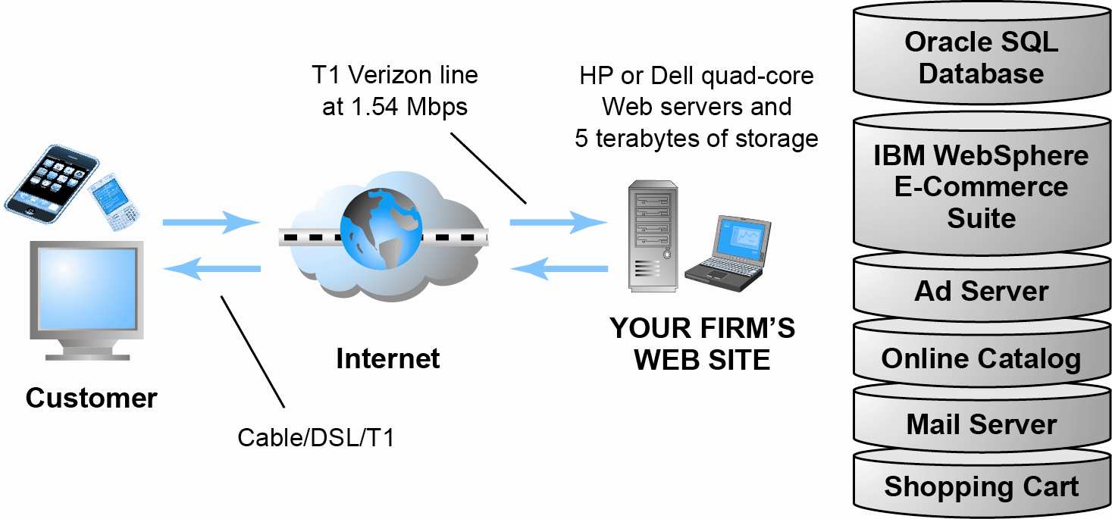
Physical Design for a Simple Web Site
Figure 4.6 (b), Page 134
Copyright © 2014 Pearson Education, Inc.
Slide 4-<number>

Slide 20
In-House vs. Outsourcing
Outsourcing: Hiring vendors to provide services involved in building site
Build own vs. outsourcing
  Build your own requires team with diverse skill set; choice of software tools; both risks and possible benefits
Host own vs. outsourcing
  Hosting: Hosting company responsible for ensuring site is accessible 24/7, for monthly fee
  Co-location: Firm purchases or leases Web server (with control over its operation), but server is located at vendor’s facility
Copyright © 2014 Pearson Education, Inc.
Slide 4-<number>

Slide 21
Curly Hair and Appillionaires
How does a small, niche Web site like NaturallyCurly.com become profitable?
Why has it never been cheaper to start an e-commerce company?
What is an Appillionaire?
Copyright © 2014 Pearson Education, Inc.
Slide 4-<number>

Slide 22
Testing, Implementation, and Maintenance
Testing
  Unit testing
  System testing
  Acceptance testing
Implementation and maintenance
  Maintenance is ongoing
  Maintenance costs: Similar to development costs
  Benchmarking
Copyright © 2014 Pearson Education, Inc.
Slide 4-<number>

Slide 23
Simple vs. Multi-tiered
Web Site Architecture
System architecture
  Arrangement of software, machinery, and tasks in an information system needed to achieve a specific functionality
Two-tier
  Web server and database server
Multi-tier
  Web application servers
  Backend, legacy databases
Copyright © 2014 Pearson Education, Inc.
Slide 4-<number>

Slide 24
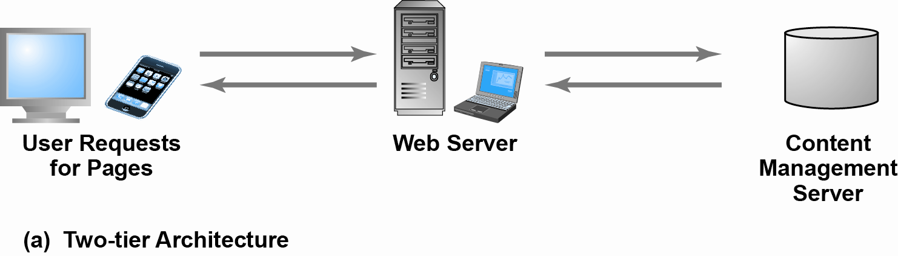
Two-Tier E-commerce Architecture
Figure 4.8(a), Page 140
Copyright © 2014 Pearson Education, Inc.
Slide 4-<number>

Slide 25
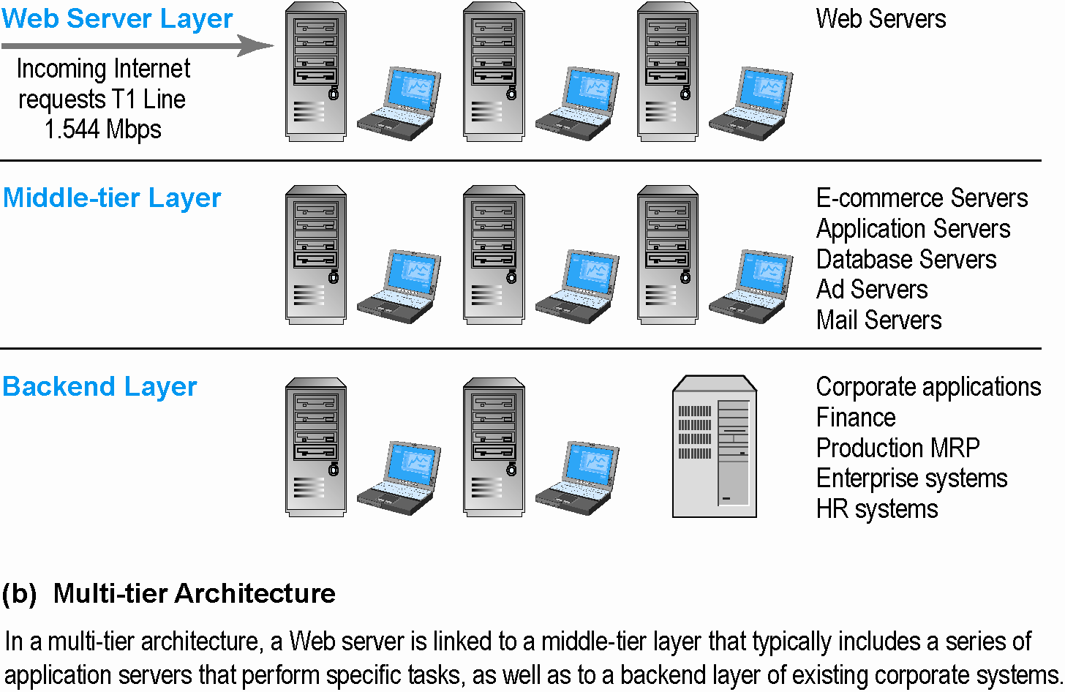
Multi-Tier E-commerce Architecture
Figure 4.8(b), Page 140
Copyright © 2014 Pearson Education, Inc.
Slide 4-<number>

Slide 26
Web Server Software
Apache
  Leading Web server software (66% of market)
  Works with UNIX, Linux OSs
Microsoft’s Internet Information Server (IIS)
  Second major Web server software (16% of market)
  Windows-based
Copyright © 2014 Pearson Education, Inc.
Slide 4-<number>

Slide 27
Site Management Tools
Basic tools
  Included in all Web servers, e.g.:
    Verify that links on pages are still valid
    Identify orphan files
Third-party software for advanced management
  Monitor customer purchases, marketing campaign effectiveness, etc.
  WebTrends Analytics 10, Google Analytics
Copyright © 2014 Pearson Education, Inc.
Slide 4-<number>

Slide 28
Dynamic Page Generation Tools
Dynamic page generation:
  Contents stored in database and fetched when needed
Common tools:
  CGI, ASP, JSP
Advantages
  Enables use of content management system (CMS)
Copyright © 2014 Pearson Education, Inc.
Slide 4-<number>

Slide 29
Application Servers
Web application servers
  Provide specific business functionality required for a Web site
  Type of middleware
    Connects traditional corporate systems to customers
  Single-function applications being replaced by integrated software tools that combine all functionality needed for e-commerce site
Copyright © 2014 Pearson Education, Inc.
Slide 4-<number>

Slide 30
E-commerce Merchant Server Software
Provides basic functionality for sales
  Online catalog
    List of products available on Web site
  Shopping cart
    Allows shoppers to set aside, review, edit selections, and then make purchase
  Credit card processing
    Typically works in conjunction with shopping cart
    Verifies card and puts through credit to company’s account at checkout
Copyright © 2014 Pearson Education, Inc.
Slide 4-<number>

Slide 31
Merchant Server Software Packages
Integrated environment that includes most of functionality needed
Three general ranges of price and functionality
  Basic: free, open source
  Midrange
  High-end
Copyright © 2014 Pearson Education, Inc.
Slide 4-<number>

Slide 32
Building Your Own E-commerce Site
Options for small firms
  Hosted e-commerce sites, e.g., Yahoo’s Merchant Solutions
    Site building tools
    E-commerce templates
  Open-source merchant server software
    Enables you to build truly custom sites
    Requires programmer with expertise, time
Copyright © 2014 Pearson Education, Inc.
Slide 4-<number>

Slide 33
The Hardware Platform
Underlying computing equipment needed for e-commerce functionality
Right-sizing your hardware platform: the demand side
  Number of simultaneous users
Right-sizing your hardware platform: the supply side
  Vertical scaling—improve individual components
  Horizontal scaling—share load with more computers
Copyright © 2014 Pearson Education, Inc.
Slide 4-<number>

Slide 34
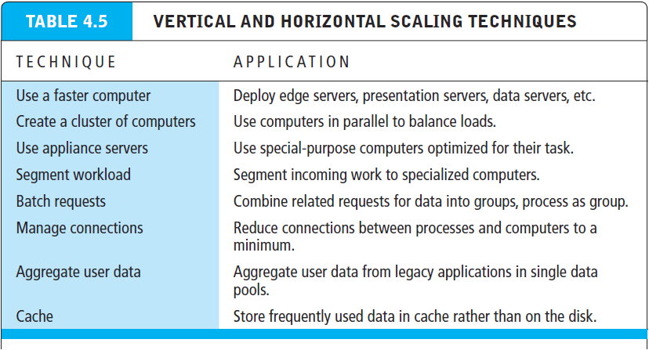
Table 4.5, Page 146
Copyright © 2014 Pearson Education, Inc.
Slide 4-<number>

Slide 35
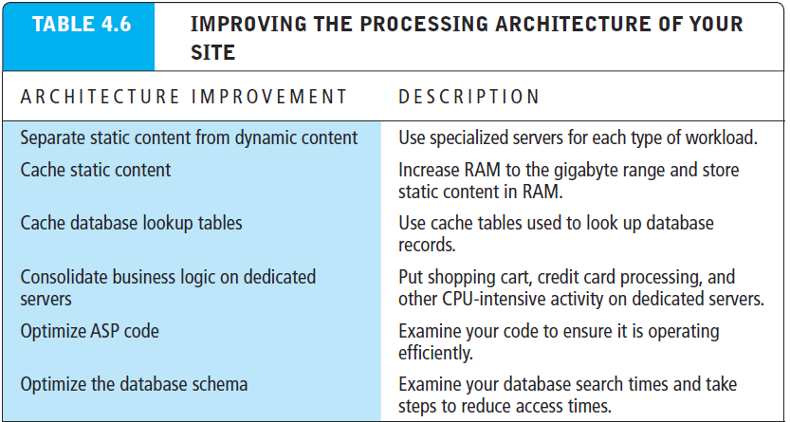
Table 4.6, Page 146
Copyright © 2014 Pearson Education, Inc.
Slide 4-<number>

Slide 36
Other E-commerce Site Tools
Web site design: Basic business considerations
  Enabling customers to find and buy what they need
Tools for Web site optimization
  Search engine optimization
    Metatags, titles, content
    Identify market niches, localize site
    Offer expertise
    Links
    Search engine ads
    Local e-commerce
Copyright © 2014 Pearson Education, Inc.
Slide 4-<number>

Slide 37
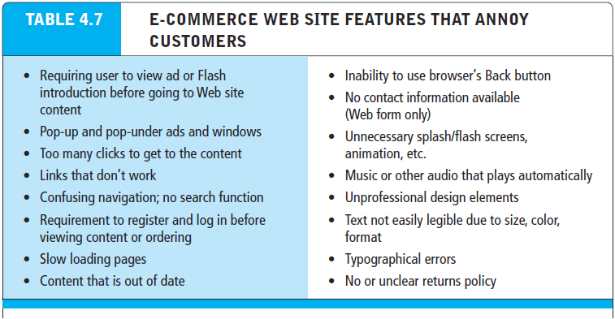
Table 4.7, Page 147
Copyright © 2014 Pearson Education, Inc.
Slide 4-<number>

Slide 38
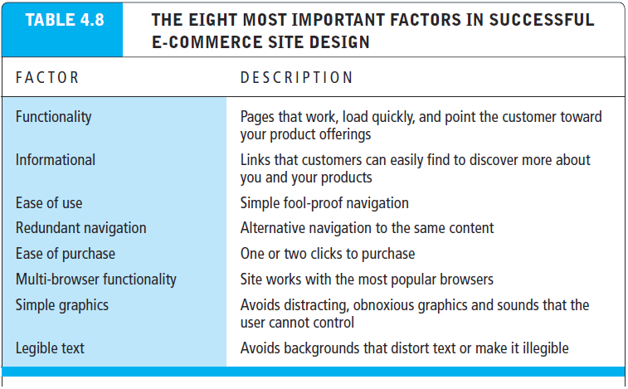
Table 4.8, Page 147
Copyright © 2014 Pearson Education, Inc.
Slide 4-<number>

Slide 39
Tools for Interactivity and Active Content
CGI (Common Gateway Interface)
ASP (Active Server Pages)
Java, Java Server Pages (JSP), and JavaScript
Web 2.0 design elements
Copyright © 2014 Pearson Education, Inc.
Slide 4-<number>

Slide 40
Developing a Mobile Web Site and Building Mobile Applications
Three types of m-commerce software
  Mobile Web site
    Responsive web design
  Mobile Web app
  Native app
Planning and building mobile presence
  Use systems analysis/design to identify unique and specific business objectives
Copyright © 2014 Pearson Education, Inc.
Slide 4-<number>

Slide 41
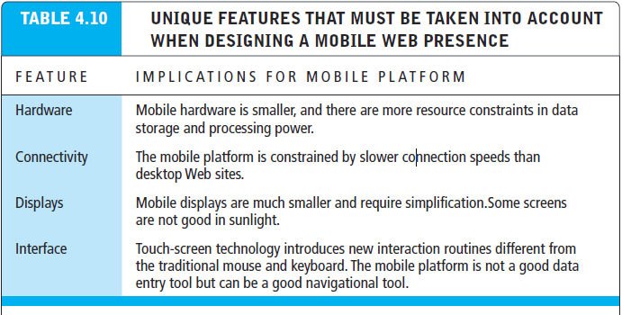
Table 4.10, Page 153
Copyright © 2014 Pearson Education, Inc.
Slide 4-<number>

Slide 42
Developing a Mobile Web Presence
Design considerations
  Platform constraints: Smartphone/tablet
Performance and cost
  Mobile Web site
    Least expensive
  Mobile app
    Can utilize browser API
  Native app
    Most expensive; requires more programming
Copyright © 2014 Pearson Education, Inc.
Slide 4-<number>

Slide 43
Building a Mobile Presence
What are the key differences between user experience on a Web site and on a mobile device?
Why would a mobile Web site or app from the same merchant need different content or functionality?
In which cases would a merchant want to develop a mobile app over a mobile Web site?
Copyright © 2014 Pearson Education, Inc.
Slide 4-<number>

Slide 44
Copyright © 2014 Pearson Education, Inc.
Slide 4-<number>

